Slide 1
PROGRESS UPDATE · AI & COMPUTER VISION
What Makes AI-Based Sparse-View 3D Gaussian Splatting Work?
Separating the roles of predicted camera poses, predicted 3D points and pose refinement
Farida Gaber · Mona Yasser
Supervisor: Dr. Wedad Sallam
Proposal + first results · 9 November 2026
Notes:
Introduce yourselves and the topic in one sentence: this project studies why AI-based methods can build 3D scenes from only a few photos, by testing which part of the method actually creates the quality. It is an AI and computer vision project, not an AR/MR application. Slides 2-12 are the plan; slides 13-20 show what we have done and our first results.

Slide 2
BACKGROUND
What is 3D Gaussian Splatting (3DGS)?
STEP 1
Photos + poses
Photos of one scene, each with its camera pose: where the camera stood and where it pointed.
STEP 2
Training
Millions of small 3D “blobs” (Gaussians) are optimized by gradient descent so their renders match the photos.
STEP 3
New views
The scene can be rendered in real time from viewpoints where no photo was taken.
For an AI researcher: it is an optimization problem. The parameters are each blob’s position, shape and colour; the loss is the difference between rendered and real photos.
Kerbl et al., SIGGRAPH 2023 · 2 / 20
Notes:
3DGS is the core technique. Explain it like training a model: we start with many small 3D blobs and use gradient descent so that rendering them from each camera reproduces the real photo. The key point for this project: step 1 needs the camera pose of every photo.

Slide 3
BACKGROUND
The camera pose problem
100+
photos: COLMAP works
COLMAP, the classic tool, matches points between overlapping photos and uses geometry to compute every camera pose.
3–9
photos: COLMAP often fails
With few photos there are too few matches, so poses are wrong or missing, and 3DGS cannot be trained well.
This is the sparse-view setting: building a 3D scene from only a few photos.
Sparse-View 3DGS · Progress update · 3 / 20
Notes:
A camera pose is simply the position plus direction of the camera. COLMAP computes it from many photos. With only a few photos it often fails; InstantSplat's authors report that COLMAP fails with three views. This is the problem the field calls sparse-view reconstruction.

Slide 4
BACKGROUND
AI models now predict the poses directly
Classic: COLMAP
Hand-designed feature matching + geometry
Needs many overlapping photos
Minutes to hours per scene
AI: MASt3R, VGGT
Large pretrained transformers
Predict poses + dense 3D points
Work with 2–3 photos, in seconds
InstantSplat = AI poses + AI 3D points + pose refinement
MASt3R gives the start; poses are then corrected during 3DGS training. Under a minute for 3–12 photos.
Leroy et al., ECCV 2024 · Wang et al., CVPR 2025 · Fan et al., arXiv 2403.20309 · 4 / 20
Notes:
This is where our AI background fits. Foundation models like MASt3R and VGGT are transformers trained on large 3D datasets. InstantSplat combines three things: AI-predicted poses, AI-predicted 3D points, and refining the poses during training. Our project asks which of these three things really matters.

Slide 5
A HIDDEN ISSUE IN CURRENT RESEARCH
Many sparse-view papers train on 3–24 photos, but use camera poses computed from all 100–300 photos.
In a real few-photo situation, these all-photo poses are not available. So we do not know how much of the reported quality comes from the poses.
Raised by MS-GS, NeurIPS 2025 (arXiv 2509.15548) · 5 / 20
Notes:
This is the motivation. Methods like FSGS train with 24 photos, but their camera poses were computed by COLMAP from all photos in the dataset. The MS-GS paper at NeurIPS 2025 pointed this out. It means the camera poses may be doing a lot of the work, and nobody has measured how much.

Slide 6
LITERATURE REVIEW
The closest papers
Paper | What it does | Mip-NeRF 360 views | What is missing
VGGT-X (2025) | Tests 2 of our 3 switches | All (dense) | Dense views only
SPARS3R (2024) | COLMAP vs MASt3R points | One count | One view count only
SDI-GS (2025) | Same pipeline as InstantSplat | 3 / 6 / 12 | No separation of parts
InstantSplat (2025) | AI poses + points + refinement | Not benchmarked | No reference-pose test
Free360 (2025) | New method; InstantSplat baseline | 3 / 6 / 9 | No separation of parts
MS-GS (2025) | Realistic pose setting | 20 | One view count only
Pi-GS (2026) | π³ model initialization | 3 / 12 | No separation of parts
About 30 papers checked in detail, including all Elicit, Consensus and Perplexity results. Full list in the novelty-check report.
arXiv 2509.25191 · 2411.12592 · 2509.11853 · 2403.20309 · 2503.24382 · 2509.15548 · 2602.03327 · 6 / 20
Notes:
These are the six most relevant papers. InstantSplat is the method we build on. VGGT-X is now the closest: it tested pose refinement on/off and random vs AI points, but only with dense views. SPARS3R compared COLMAP points with MASt3R points at one view count. SDI-GS uses the same pipeline as InstantSplat but does not separate its parts. Free360 gives us the evaluation protocol and the numbers we will reproduce first.

Slide 7
NOVELTY CHECK
Our first idea had already been done
First idea: compare COLMAP-based 3DGS with a COLMAP-free method at different numbers of photos on Mip-NeRF 360.
COLMAP vs COLMAP-free
Done: InstantSplat, VGGT-X, He et al. 2025
Several view counts
Done: Free360 (3/6/9), Pi-GS (3/12) on Mip-NeRF 360
Pose error + time
Done: InstantSplat, VGGT-X report both
Conclusion: on its own this would be a replication. It needed a sharper “why” question.
Sparse-View 3DGS · Progress update · 7 / 20
Notes:
Be honest here; it shows good research practice. Our first idea compared COLMAP and COLMAP-free methods at different photo counts. The literature search showed this has already been done by several papers. So we kept the topic but changed the question from 'which is better?' to 'why does it work?'.

Slide 8
NOVELTY CHECK
What is still open: the research gap
Question | Status | Notes
COLMAP points vs AI points | Partly done | SPARS3R, one view count
Pose refinement on vs off | Partly done | VGGT-X, dense views only
AI points vs random points | Partly done | VGGT-X, Foroutan: dense only
Reference poses vs AI poses, same pipeline | Not found | MS-GS raises the issue
All three together, 3 / 6 / 9 views | Not found | Our planned contribution
Type of work: an existing method + a new controlled experimental setup (analysis / ablation study). Not a new algorithm.
Checked 3 Nov 2026 with Elicit, Consensus and Perplexity · not finding a paper does not prove novelty · 8 / 20
Notes:
Say clearly what is new and what is not. Two switches were tested by VGGT-X, but only with dense views. The reference-pose swap and all three switches together with 3 to 9 photos were not found by us or by Elicit, Consensus and Perplexity. That is the gap. We will repeat the search before submission because the field moves fast.

Slide 9
RESEARCH QUESTION
How much of the quality comes from the AI’s predicted poses, its predicted 3D points, and pose refinement, and how does this change from 3 to 9 photos?
In particular: do VGGT-X’s dense-view findings still hold with only 3–9 photos?
RQ1 · Poses
How much quality is lost when AI poses replace the reference poses?
RQ2 · 3D points
How useful are the AI’s dense 3D points compared with random points?
RQ3 · Refinement
When does correcting the poses during training help, and when does it fail?
Sparse-View 3DGS · Progress update · 9 / 20
Notes:
This is the most important slide. The main question is about cause, not just comparison. Each sub-question maps to one controlled experiment on the next slide. Hypotheses: reference poses help most at 3 views; with dense views VGGT-X found random points work about as well as AI points, but with few photos we expect AI points to matter much more; refinement helps when the starting pose error is small.

Slide 10
METHOD
Change one part at a time (ablation)
Config | Camera poses | 3D points | Refinement | What it tells us
C1 | Reference (dataset) | MASt3R | Off | Upper bound
C2 | MASt3R | MASt3R | Off | Pure AI prediction
C3 | MASt3R | MASt3R | On | Full InstantSplat
C4 | MASt3R | Random | On | Value of AI points
C5* | VGGT | VGGT | On | Newer AI model
C1 vs C2 → RQ1 · C3 vs C4 → RQ2 · C2 vs C3 → RQ3 · *optional. Random = same number of points, uniform in the scene box. Training photos only; same code, iterations and test-pose alignment for all.
Base code: github.com/NVlabs/InstantSplat · 10 / 20
Notes:
An ablation study switches off or replaces one component at a time, which is standard in deep learning research. Everything uses the existing InstantSplat code; we only add small switches: load the dataset poses, replace the points with random ones, and freeze pose refinement. C5 with VGGT is optional if time allows.

Slide 11
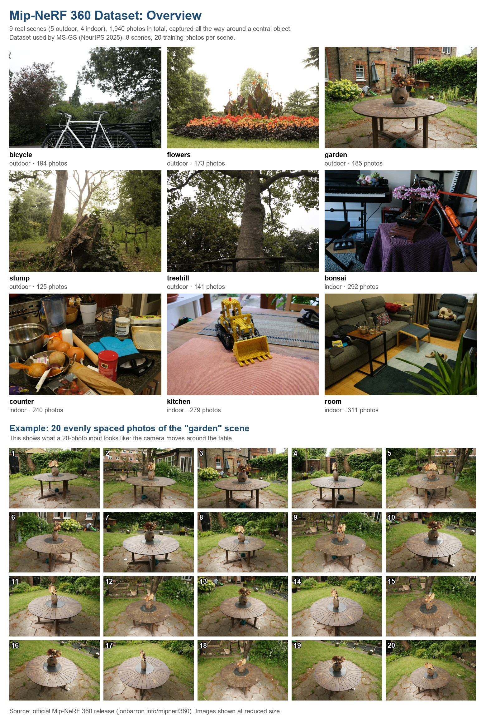
DATASET AND PROTOCOL
Mip-NeRF 360, following Free360’s setup
9 real 360° scenes, 1,940 photos (5 outdoor, 4 indoor)
8 scenes used; flowers excluded, as in Free360
Reference poses already included (COLMAP, all photos)
Test: every 8th photo · Train: 3, 6, 9 photos (training photos only)
Download: 360_v2.zip (12.5 GB) + extra scenes
Week-1 reproduction target (InstantSplat, Free360 Table 1)
Views | PSNR ↑ | SSIM ↑ | LPIPS ↓
3 | 14.10 | 0.296 | 0.529
6 | 15.83 | 0.351 | 0.480
9 | 17.16 | 0.402 | 0.443
Barron et al., CVPR 2022 · Bao et al., arXiv 2503.24382 · 11 / 20
Notes:
Mip-NeRF 360 is the standard benchmark for 360-degree scenes. It already contains COLMAP poses computed from all photos, which we use as the reference poses (very accurate, but not perfect), so we do not need to run COLMAP ourselves. We follow Free360's protocol so that our first milestone is to reproduce their published InstantSplat numbers. That checks our setup before the new experiments.

Slide 12
EVALUATION
What we will measure
Image quality
PSNR, SSIM (higher is better) and LPIPS (lower is better) on held-out test photos
Camera pose error
Our pose_error.py: position error (ATE), direction error and relative error (RPE) vs the reference cameras
Cost
Training time per scene and peak GPU memory
Visual results
Side-by-side renders and quality-vs-photos charts for each configuration
96 main runs = 4 configurations (C1–C4) × 3 view counts × 8 scenes, plus seed repeats on 1 scene. C5 only if time allows.
Sparse-View 3DGS · Progress update · 12 / 20
Notes:
PSNR and SSIM compare pixels and structure; LPIPS uses a deep network and is closest to human judgement. The pose error measures how far the cameras are from the reference ones. InstantSplat's own pose numbers turned out to be unreliable, so we wrote and tested our own script (slide 17). Measuring both image quality and pose error lets us test whether better poses really give better images.

Slide 13
PRACTICAL PLAN
Tools and hardware
Software
InstantSplat (NVlabs) – base code
MASt3R, VGGT – pretrained AI models
PyTorch 2.14 + CUDA 13 (current Colab)
Reference poses read from the dataset (COLMAP files)
LPIPS, NumPy, pandas – evaluation
GitHub, Google Drive, Overleaf – sharing and writing
GPU in use: Google Colab, Tesla T4 (15 GB)
AI prediction, 3DGS training, rendering. Peak use so far: 4.9 GB. Results saved to Drive after every run.
Back-up: RTX 5090 workstation (32 GB)
Used only if Colab is too slow or limited. All final runs on ONE GPU type, so times are comparable.
Sparse-View 3DGS · Progress update · 13 / 20
Notes:
Everything is existing, free software. We moved the experiments to Google Colab with a T4 GPU so both of us can run them from any laptop. Setup and results live on a shared Google Drive and the code on GitHub. The RTX 5090 workstation stays as the back-up. All final numbers will come from one GPU type.

Slide 14
PROGRESS · 9 NOVEMBER (BLOCK 1 RUNS TO 11 NOV)
Block 1: the pipeline works on Colab
STEP 1
Setup
InstantSplat + MASt3R installed on a Colab T4; 4 compatibility fixes
STEP 2
Data
Mip-NeRF 360, 8 scenes, small images; reference poses included
STEP 3
Split rule
Free360 rule: every 8th photo = test; 3 / 6 / 9 training photos
STEP 4
Baseline
Full InstantSplat (C3) on garden + bonsai: 6 runs
STEP 5
Pose error
Our own pose_error.py, checked with automatic tests
✓
✓
✓
✓
✓
Still open by 11 Nov: re-run with notebook v2 (valid pose error + dataset copy on Drive), Mona runs the notebook on her account, Overleaf + Zotero, hand-off call.
Sparse-View 3DGS · Progress update · 14 / 20
Notes:
This is what we did so far in the first block, which ends on 11 November. We set up the full InstantSplat pipeline on free Google Colab, downloaded the dataset, used the same train/test rule as the Free360 paper, ran the baseline on two scenes, and wrote our own pose-error script. The notebook can be restarted at any time; finished runs are skipped.

Slide 15
FIRST RESULT · MILESTONE M1
Our baseline matches the published numbers
M1 PASSED
+0.60 / +0.56 / +0.03
dB difference at 3 · 6 · 9 photos. Target was within 1.5 dB.
What it means
Our setup is correct, so we can trust the next experiments. Quality rises with more photos, as expected.
Free360: Bao et al., arXiv 2503.24382, Table 1 · ours: 2 of the 8 scenes, so small differences are expected · 15 / 20
Notes:
This is our first milestone. Before changing anything, we had to show that our setup gives the same numbers as a published paper. Free360 reports InstantSplat at 14.10, 15.83 and 17.16 dB. We get 14.70, 16.39 and 17.19. Their numbers are averages over 8 scenes and ours over 2, so a small difference is normal. SSIM and LPIPS are also close.

Slide 16
FIRST RESULT · DETAILS
Baseline per scene (full InstantSplat, C3)
Scene | Photos | PSNR ↑ | SSIM ↑ | LPIPS ↓ | Time (min) | GPU (GB)
garden | 3 | 14.65 | 0.273 | 0.555 | 8.9 | 3.2
garden | 6 | 17.58 | 0.345 | 0.396 | 12.4 | 3.7
garden | 9 | 18.04 | 0.344 | 0.377 | 16.8 | 4.8
bonsai | 3 | 14.75 | 0.358 | 0.581 | 9.9 | 3.3
bonsai | 6 | 15.20 | 0.390 | 0.503 | 15.4 | 3.7
bonsai | 9 | 16.34 | 0.434 | 0.449 | 21.1 | 4.9
What we see
PSNR and LPIPS improve from 3 to 9 photos in both scenes
garden (outdoor) gains most from 3 to 6 photos: +2.9 dB
bonsai (indoor) improves more slowly
GPU memory stays below 5 GB, so a T4 is enough
Sparse-View 3DGS · Progress update · test photos: garden 24, bonsai 37 · 16 / 20
Notes:
Here are the six runs. Image quality improves with more photos in both scenes. The outdoor garden scene benefits most when going from 3 to 6 photos. Memory is low, so the free T4 GPU is enough; time is the limit, not memory.

Slide 17
QUALITY CONTROL
Two hidden problems found and fixed
PROBLEM 1 · TEST CAMERAS
InstantSplat started each test camera 80–90° away from the right direction (360° scenes).
Fix
Start each test camera from its reference pose, aligned to the AI’s cameras. Same rule for every configuration.
Effect
garden PSNR: 14.23 / 14.52 / 14.76 → 14.65 / 17.58 / 18.04
PROBLEM 2 · POSE ERROR
InstantSplat’s pose-error code mixes two camera formats, giving impossible values (up to 145°).
Fix
Our own pose_error.py: one scale-rotation-shift alignment, then position, direction and relative errors.
Effect
Passes automatic tests; valid pose numbers from the next runs
Sparse-View 3DGS · Progress update · details in LOG.md on GitHub · 17 / 20
Notes:
We checked every step instead of trusting the code. First: for 360-degree scenes InstantSplat's default starting guess for the test cameras was 80 to 90 degrees wrong, which hid the benefit of more photos. We fixed it with one rule used for all configurations. Second: InstantSplat's pose-error numbers were not valid because the code mixes two camera formats. We wrote our own script and tested it. Both fixes matter for a fair comparison.

Slide 18
COST
Time is the limit, not memory
14 min
average per run on the free T4 (9–21 min)
65%
of each run is tuning the test cameras before measuring
22.5 h
of GPU time for all 96 runs (about 11 h per person)
Options for the 96 runs (decision before 16 Nov)
Split over our two Colab accounts, as planned · paid Colab compute units for a guaranteed GPU
RTX 5090 workstation as the back-up · smallest plan: 4 scenes = 48 runs
Sparse-View 3DGS · Progress update · 18 / 20
Notes:
Each run takes about 14 minutes on the free GPU. Most of that time is spent tuning the test camera poses, which the protocol requires. The full study needs about 22.5 GPU hours. We will split it over our two accounts; if free Colab is too limited we can buy compute units or use the workstation, and the smallest fallback is four scenes.

Slide 19
PLAN
Timeline to 25 November
9–11 Nov · now
Block 1 · Farida
Setup + baseline: main result done, 4 small items left
12–15 Nov
Block 2 · Mona
Add switches C1–C4; pilot on 2 scenes
16–18 Nov
Block 3 · Both
96 runs, tables, figures
19–23 Nov
Block 4 · Mona
Analysis and paper draft
24–25 Nov
Final · Both
Supervisor feedback, delivery
…
…
…
…
…
Next: Block 2 (12–15 Nov)
Reference poses (C1), refinement off (C2) and random points (C4), each tested on 1 scene, then 24 pilot runs on 2 scenes.
Sparse-View 3DGS · Progress update · each person leads one block at a time, then hands over · 19 / 20
Notes:
We work as a relay: each block has one lead and ends with a short handover. Block 1 is almost finished: the main result is done and four small items close by 11 November. Next, Mona leads Block 2: adding the three switches and a pilot run. Then both of us run the 96 experiments, and the last week is for writing.

Slide 20
SUMMARY
Where we are and what we need
Done so far
Research gap confirmed (Elicit, Consensus, Perplexity)
Full pipeline running on Colab, shared with the team
Published numbers reproduced (within 0.6 dB)
Two hidden problems found and fixed
Questions for you
Is an analysis / ablation study acceptable, or is a new method required?
Target output: course report, thesis chapter or workshop paper?
Compute for the 96 runs: free Colab, paid units or the workstation?
Thank you.
Sparse-View 3DGS · Progress update · 20 / 20
Notes:
Close with the status in one sentence: the setup is verified against a published paper, and we are ready to run the actual study. Then ask the three questions; the answers decide the final scope and where we run the experiments.

